Slide 1
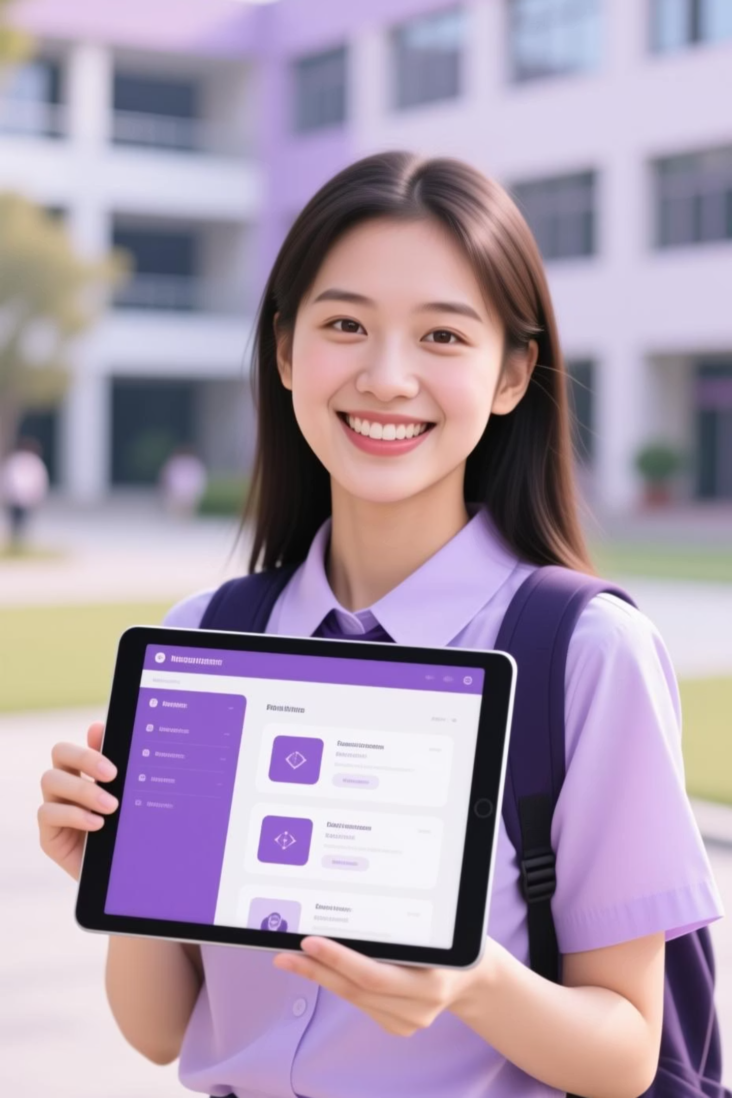
Building Your Digital Identity: The Student Digital Portfolio
Presented by: R. Kavya
Register No: 24131021802522024
Department: BSc Computer Science
College: Knc College for Women / Annamalai University

Slide 2
Project Title
Empowering Student Success Through a Dynamic Digital Portfolio
This project focuses on creating an innovative and comprehensive digital portfolio solution for students, enabling them to effectively showcase their academic achievements, practical skills, and creative projects to a wider audience.

Slide 3
Agenda: Your Roadmap to a Powerful Portfolio
1
Problem Statement
Identifying the challenges students face in showcasing their capabilities.
2
Project Overview
A high-level look at our proposed solution and its objectives.
3
End Users
Understanding who benefits most from this digital portfolio.
4
Tools and Technologies
The essential building blocks behind our portfolio design.
5
Portfolio Design and Layout
Exploring the aesthetics and user experience.
6
Features and Functionality
Key capabilities that make our portfolio stand out.
7
Results and Screenshots
A visual demonstration of the portfolio in action.
8
Conclusion
Summarizing key insights and future directions.
9
Github Link
Accessing the project's source code and resources.

Slide 4

The Challenge: Bridging the Gap Between Talent and Opportunity
In today's competitive academic and professional landscape, students often struggle to effectively demonstrate their diverse skills and project work beyond traditional resumes and grades.
Limited visibility of practical skills
Difficulty in showcasing project-based learning
Lack of a centralized, accessible platform for achievements
"How do students truly stand out when a resume can only say so much?"

Slide 5
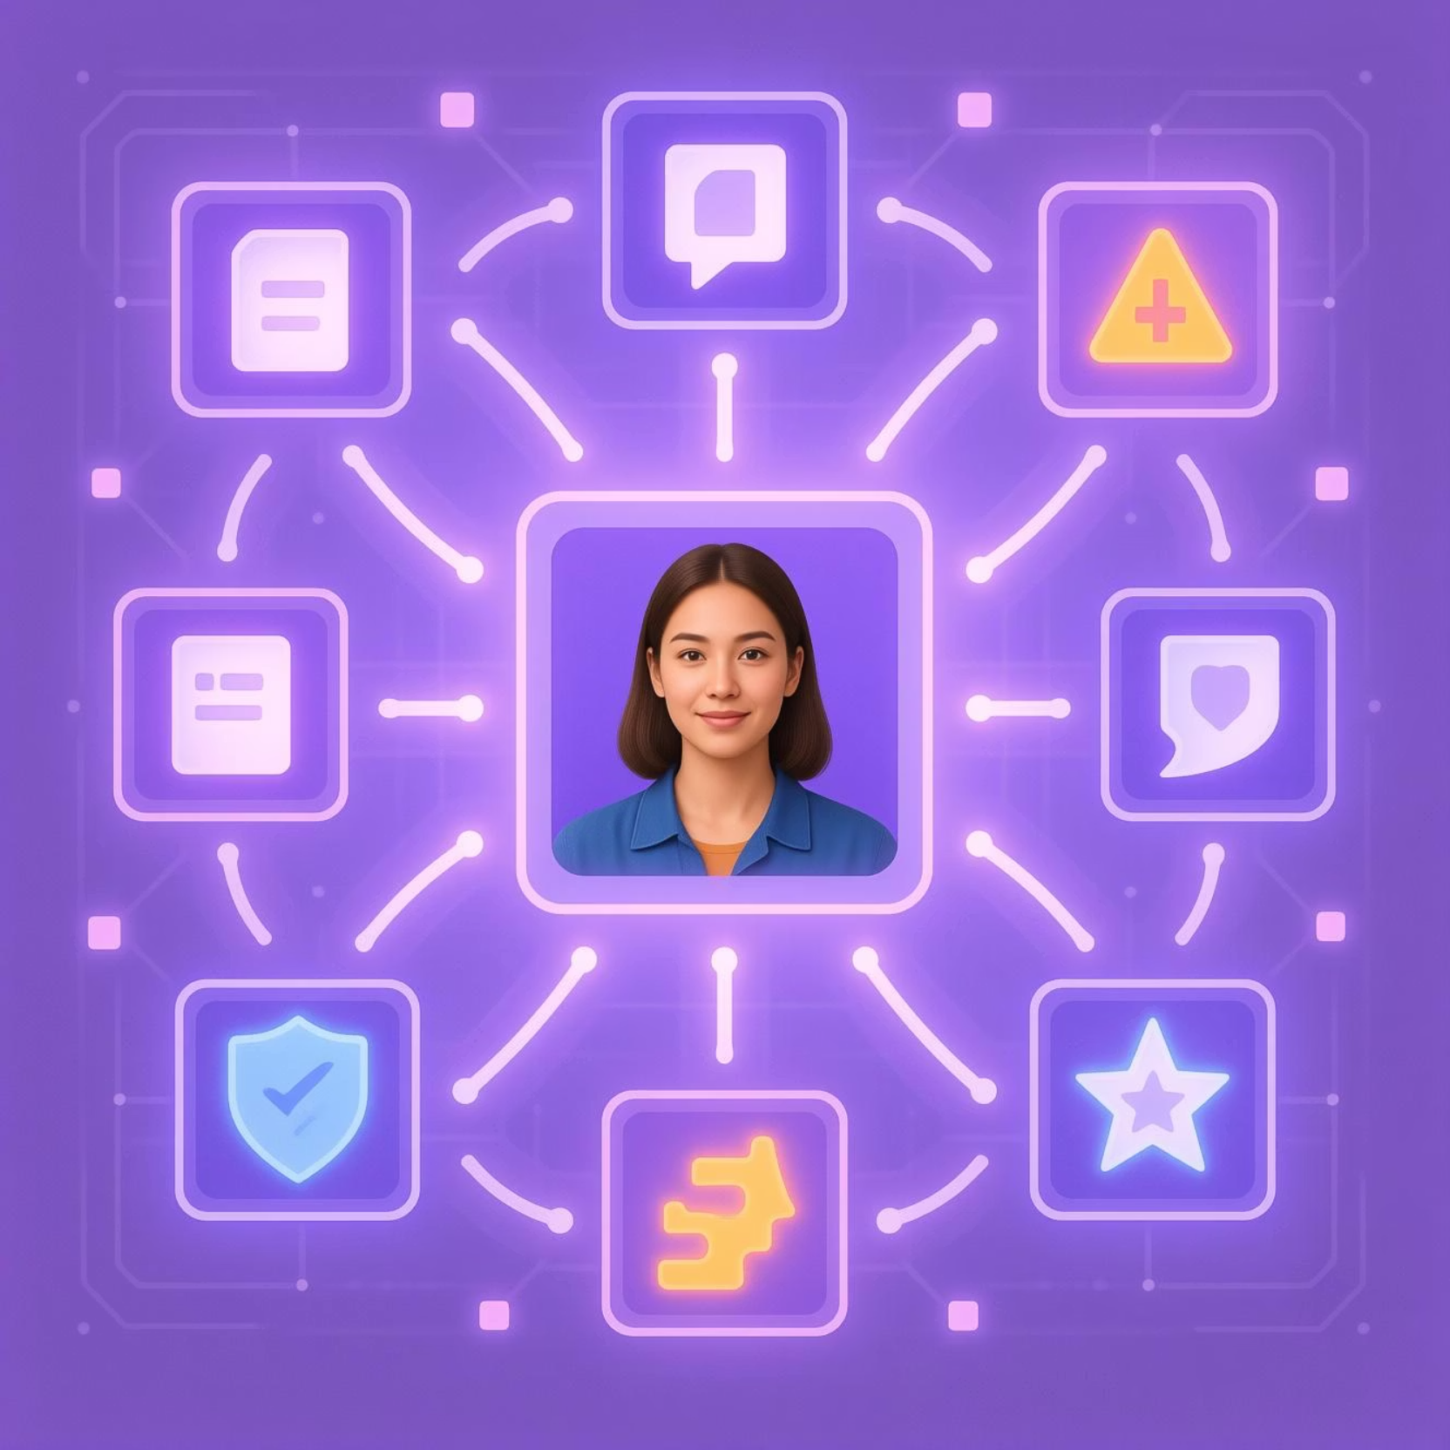
Project Overview: Your Dynamic Showcase
Our digital portfolio project aims to provide students with a modern, intuitive, and interactive platform to present their academic journey, practical skills, and creative endeavors.
Centralized hub for all achievements
Visually engaging and customizable layouts
Easy sharing and accessibility for various stakeholders
This platform moves beyond static documents, offering a living testament to a student's growth and potential.

Slide 7




Who Benefits? Our Key End Users
Students
Employers & Recruiters
To build a professional online presence, track progress, and secure internships/jobs.
To quickly assess practical skills, project experience, and a candidate's potential beyond the resume.
Faculty & Mentors
Parents & Peers
To guide students, evaluate coursework, and showcase departmental achievements.
To celebrate achievements and gain insights into academic and career paths.
Each user group gains unique value from an easily accessible and comprehensive digital record of student accomplishments.

Slide 8
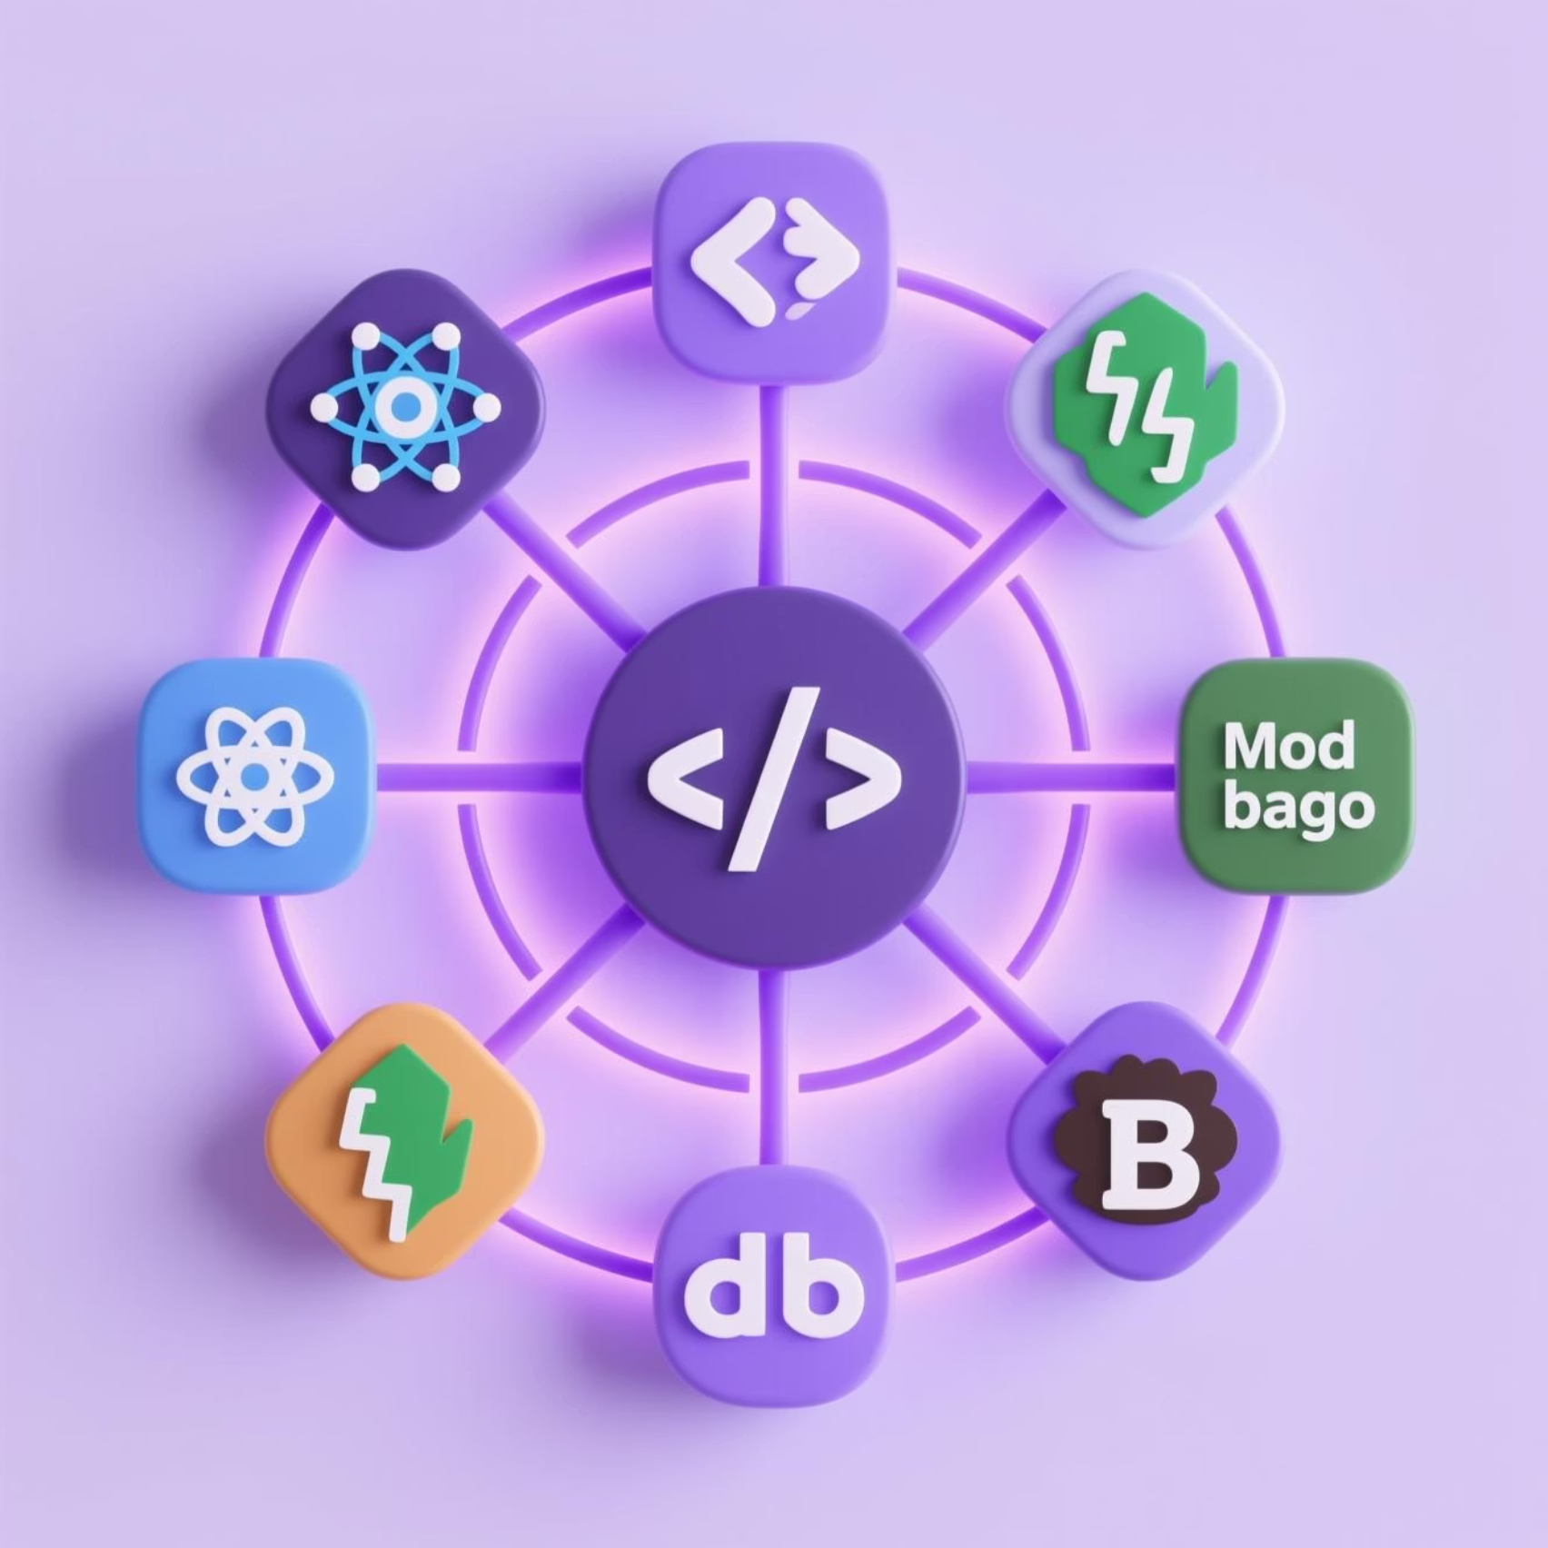
The Toolkit: Technologies Driving Our Vision
Our digital portfolio is built using a robust stack of modern web technologies, ensuring a dynamic, responsive, and secure user experience.
Frontend: React.js for interactive UI, coupled with HTML5 and CSS3 for structure and styling.
Backend: Node.js with Express.js for scalable API development and efficient data handling.
Database: MongoDB for flexible, NoSQL data storage, perfect for diverse portfolio content.
Version Control: Git & GitHub for collaborative development and project management.
This combination provides a powerful foundation for a feature-rich and maintainable application.

Slide 9



Crafting the Experience: Portfolio Design & Layout
Our design philosophy prioritizes clarity, elegance, and user-centricity. The layout is intuitive, allowing students to effortlessly organize and customize their content, while ensuring a polished presentation for viewers.
Clean Aesthetics
Responsive Layout
Intuitive Navigation
Minimalist design with a focus on content. Customizable themes and color palettes.
Optimized for seamless viewing across desktops, tablets, and mobile devices.
Easy drag-and-drop functionality for content arrangement and section reordering.
The goal is to make the student's work shine, not to distract with overly complex interfaces.

Slide 10
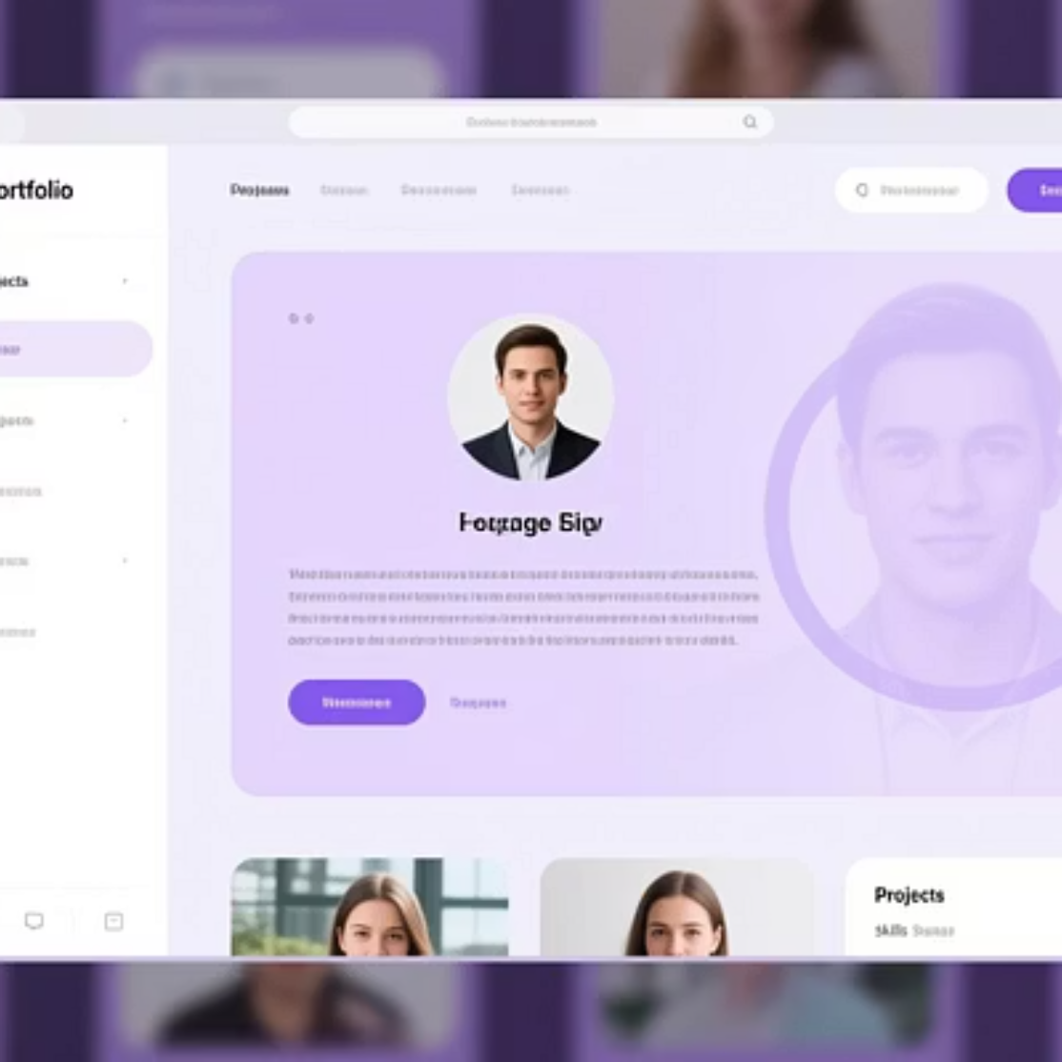
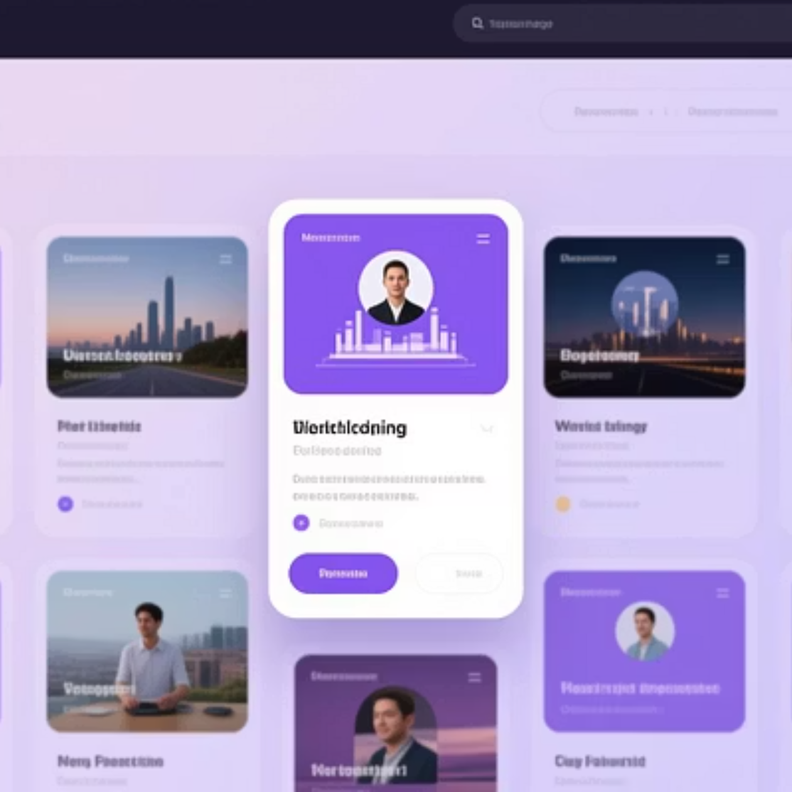
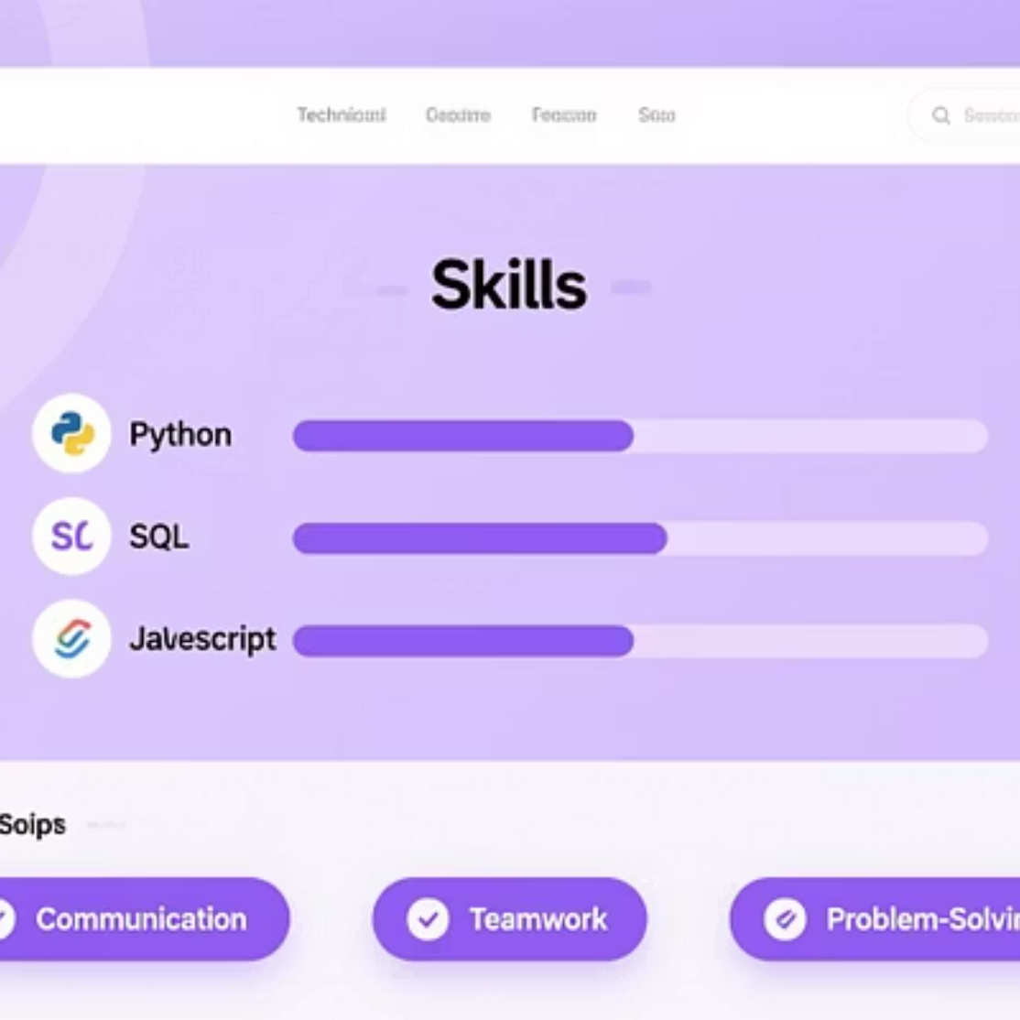
Results: A Glimpse into the Digital Portfolio
Here are some examples and screenshots demonstrating the dynamic capabilities and aesthetic appeal of the digital portfolio. Observe how various projects and skills are elegantly displayed.
The visual presentation speaks volumes, transforming a collection of work into a compelling narrative.

Slide 11
Conclusion: Your Future, Digitally Defined
The Student Digital Portfolio provides an indispensable tool for every student, offering a professional, versatile, and accessible platform to narrate their unique academic and professional story. This project empowers students to confidently step into their future, showcasing their full potential.
Key Takeaways
Next Steps
Enhanced visibility for student achievements
Continuous feature enhancements and UI/UX improvements
Seamless showcasing of practical skills and projects
A professional digital identity for career advancement
Integration with academic and professional networks
Community feedback and iterative development
Access the project on GitHub for more details and contributions.

